Slide 1

Lets Make sustainability a Necessity of Packaging
brotherspackaging2020@gmail.com
PUSHPENDRA RAWAT
Mobile - +918446036105
Raghvendra Rawat
Mobile - +917709987178
BROTHERS PACKAGING
Lets Make Sustainability a Necessity of Packaging

Slide 2
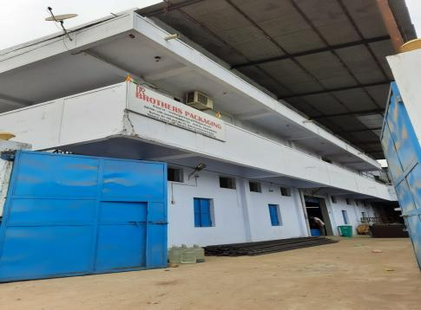
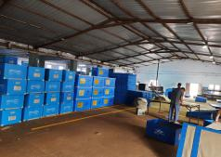
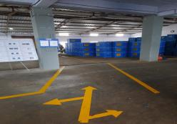
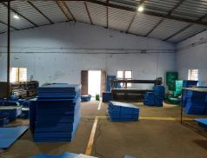
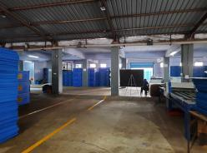
About us
After serving the industry as it is copy paste
BROTHERS PACKAGING
Lets Make Sustainability a Necessity of Packaging

Slide 3
Our Infrastructure
We have state of the art manufacturing facility to satisfy the demands of the market, separated in the area of 14000sq ft decided in different section (Manufacturing/Store/Quality/Development and fabrications)
BROTHERS PACKAGING
Lets Make Sustainability a Necessity of Packaging

Slide 4
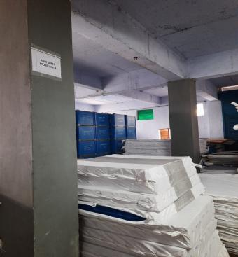
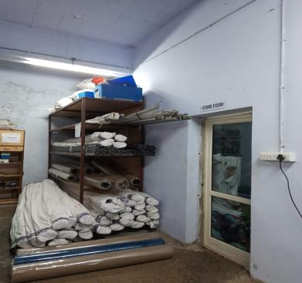
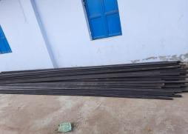
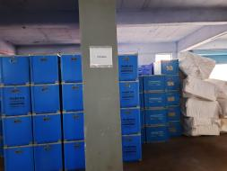
Our Infrastructure
BROTHERS PACKAGING
Lets Make Sustainability a Necessity of Packaging

Slide 5
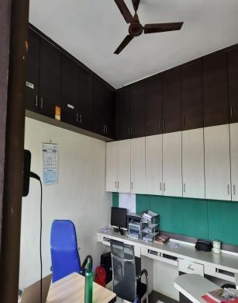
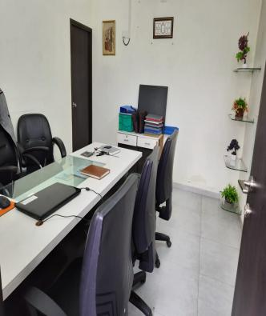
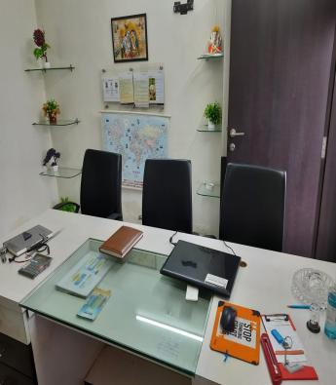
Office
BROTHERS PACKAGING
Lets Make Sustainability a Necessity of Packaging

Slide 6
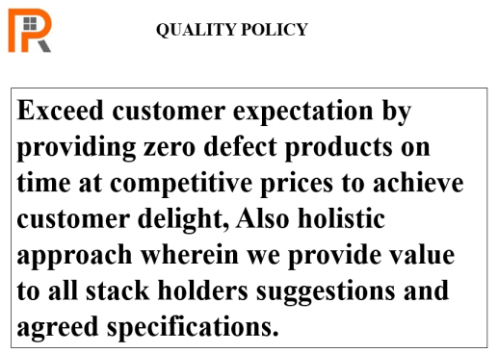
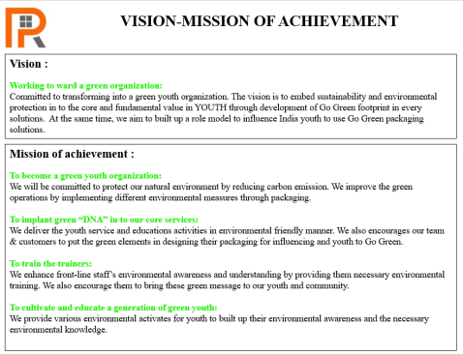
Quality policy & Vision-Mission of achievement
BROTHERS PACKAGING
Lets Make Sustainability a Necessity of Packaging

Slide 7
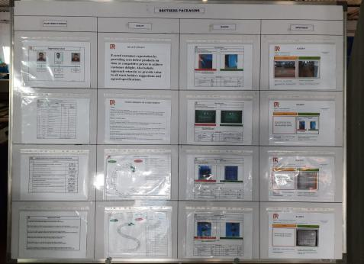
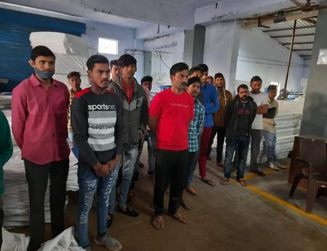
Quality
We are monitoring plant performance and quality to sustain the system and also providing training to employee for skill development and improve quality.
BROTHERS PACKAGING
Lets Make Sustainability a Necessity of Packaging

Slide 8
Innovative team
We are monitoring plant performance and quality to sustain the system and also providing training to employee for skill development and improve quality.
BROTHERS PACKAGING
Lets Make Sustainability a Necessity of Packaging

Slide 9
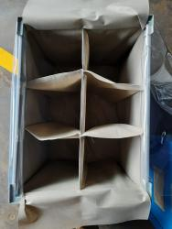
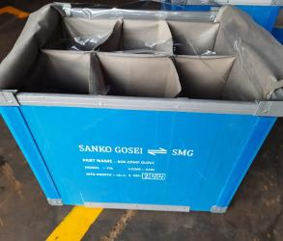
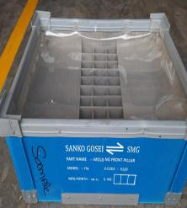
Products
Our products.
PP Tray.
PP box.
ESD PP tray
ESD PP sheet
MS Trolly with fabrication.
Crate with Fabrication.
EPE Foam with Fabrication.
EVA Foam with fabrication.
Bubble roll.
Bubble bag.
Stretch film
PVC transparent Bag.
PVC transparent roll.
BROTHERS PACKAGING
Lets Make Sustainability a Necessity of Packaging

Slide 10
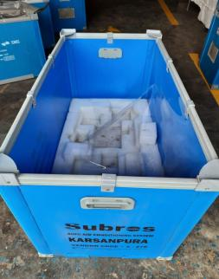
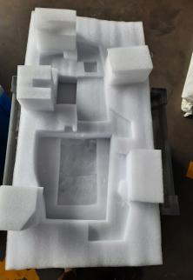
Products
Our products.
PP Tray.
PP box.
ESD PP tray
ESD PP sheet
MS Trolly with fabrication.
Crate with Fabrication.
EPE Foam with Fabrication.
EVA Foam with fabrication.
Bubble roll.
Bubble bag.
Stretch film
PVC transparent Bag.
PVC transparent roll.
BROTHERS PACKAGING
Lets Make Sustainability a Necessity of Packaging

Slide 11
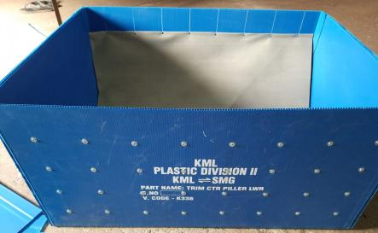
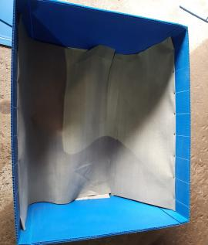
Products
Our products.
PP Tray.
PP box.
ESD PP tray
ESD PP sheet
MS Trolly with fabrication.
Crate with Fabrication.
EPE Foam with Fabrication.
EVA Foam with fabrication.
Bubble roll.
Bubble bag.
Stretch film
PVC transparent Bag.
PVC transparent roll.
BROTHERS PACKAGING
Lets Make Sustainability a Necessity of Packaging

Slide 12
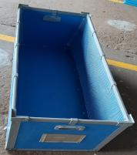
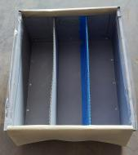
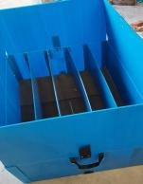
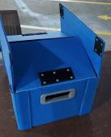
Products
Our products.
PP Tray.
PP box.
ESD PP tray
ESD PP sheet
MS Trolly with fabrication.
Crate with Fabrication.
EPE Foam with Fabrication.
EVA Foam with fabrication.
Bubble roll.
Bubble bag.
Stretch film
PVC transparent Bag.
PVC transparent roll.
BROTHERS PACKAGING
Lets Make Sustainability a Necessity of Packaging

Slide 13
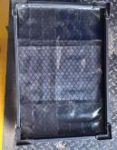
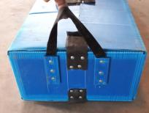
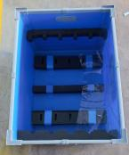
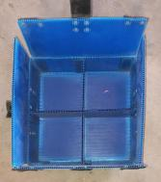
Products
Our products.
PP Tray.
PP box.
ESD PP tray
ESD PP sheet
MS Trolly with fabrication.
Crate with Fabrication.
EPE Foam with Fabrication.
EVA Foam with fabrication.
Bubble roll.
Bubble bag.
Stretch film
PVC transparent Bag.
PVC transparent roll.
BROTHERS PACKAGING
Lets Make Sustainability a Necessity of Packaging

Slide 14
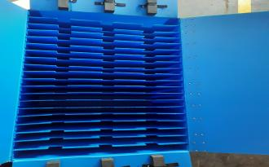
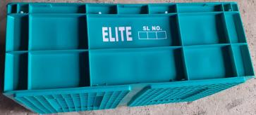
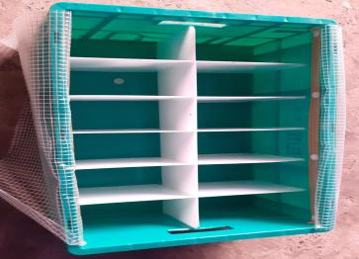
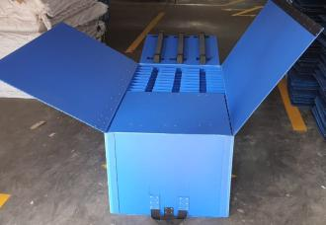
Products
Our products.
PP Tray.
PP box.
ESD PP tray
ESD PP sheet
MS Trolly with fabrication.
Crate with Fabrication.
EPE Foam with Fabrication.
EVA Foam with fabrication.
Bubble roll.
Bubble bag.
Stretch film
PVC transparent Bag.
PVC transparent roll.
BROTHERS PACKAGING
Lets Make Sustainability a Necessity of Packaging

Slide 15
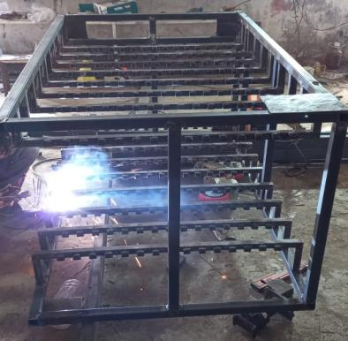
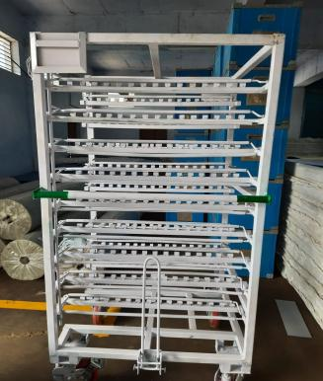
Products
Our products.
PP Tray.
PP box.
ESD PP tray
ESD PP sheet
MS Trolly with fabrication.
Crate with Fabrication.
EPE Foam with Fabrication.
EVA Foam with fabrication.
Bubble roll.
Bubble bag.
Stretch film
PVC transparent Bag.
PVC transparent roll.
BROTHERS PACKAGING
Lets Make Sustainability a Necessity of Packaging

Slide 16
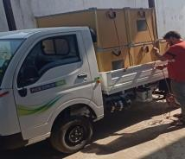
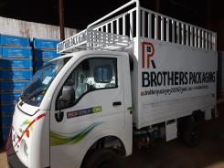
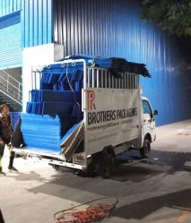
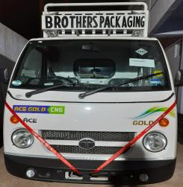
Transportation facility
We are a equipped with dedicated vehicle to serve the increasing demand on time of customers.
BROTHERS PACKAGING
Lets Make Sustainability a Necessity of Packaging

Slide 17
























Industry we serve
BROTHERS PACKAGING
Lets Make Sustainability a Necessity of Packaging

Slide 18
Our Customers
BROTHERS PACKAGING
Lets Make Sustainability a Necessity of Packaging

Slide 19

BROTHERS PACKAGING
Lets Make Sustainability a Necessity of Packaging

